Slide 1
Interview Q

Slide 2
Google

Slide 3
Google Phone
If there was a smell sensing sensor, how would you use it
3 google products you like, chose 1, critique it, improve it
How do you design video streaming product like netflix for google
Non-tech
design a gas station
design an entrance to New York Times building
Evaluate readiness for redesign of self driving car
Estimate the number of Uber rides in San Jose last year
If you are given a magical stone that cures cancer, what do you do with it
Storage cost for Google photos
Design a disaster recovery system for city of tokyo, for year 2020
Design an onboarding system for aws customer to gcp
If you found a box which can generate diamonds - what would you do as the VP of products for that company

Slide 4
Google Phone (2)
What would you improve in phone
Should MSFT build an app for the apple tv
Fav product - how would you build it for limited internet or connectivity
Dlp
How will you take to market
Size the market
Market entry
Safeway - customer experience, estimation
What are you doing
What is the most challenging thing
What was most surprising when you started PM

Slide 5
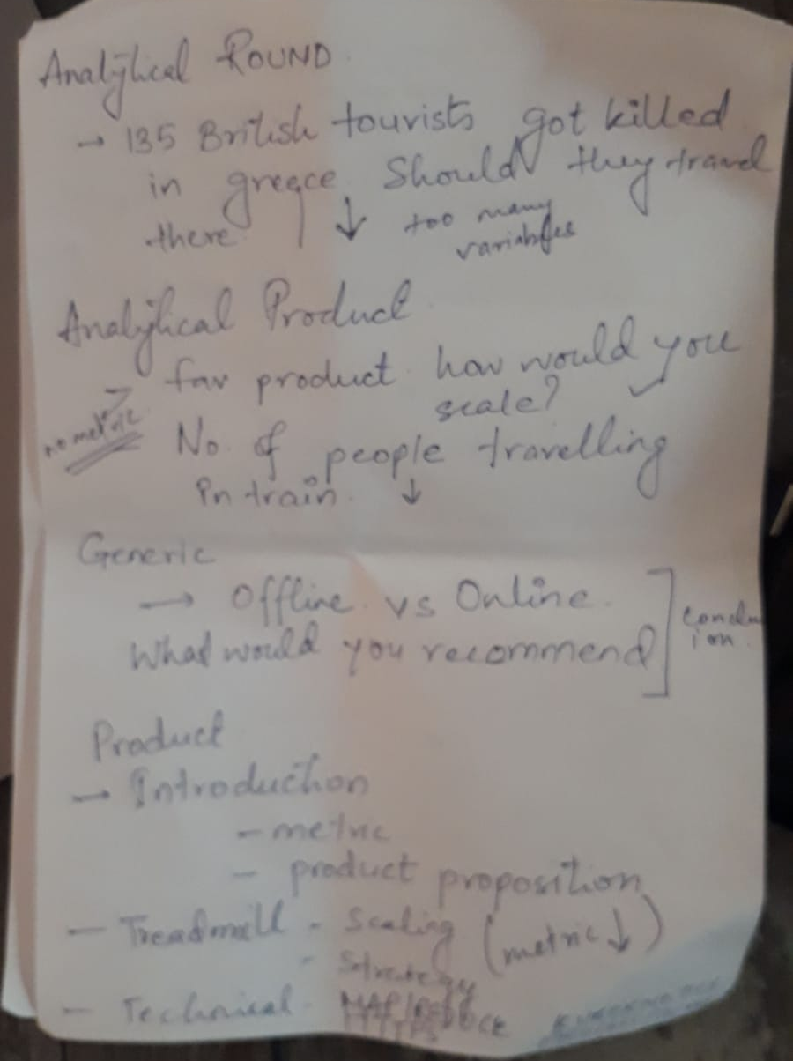
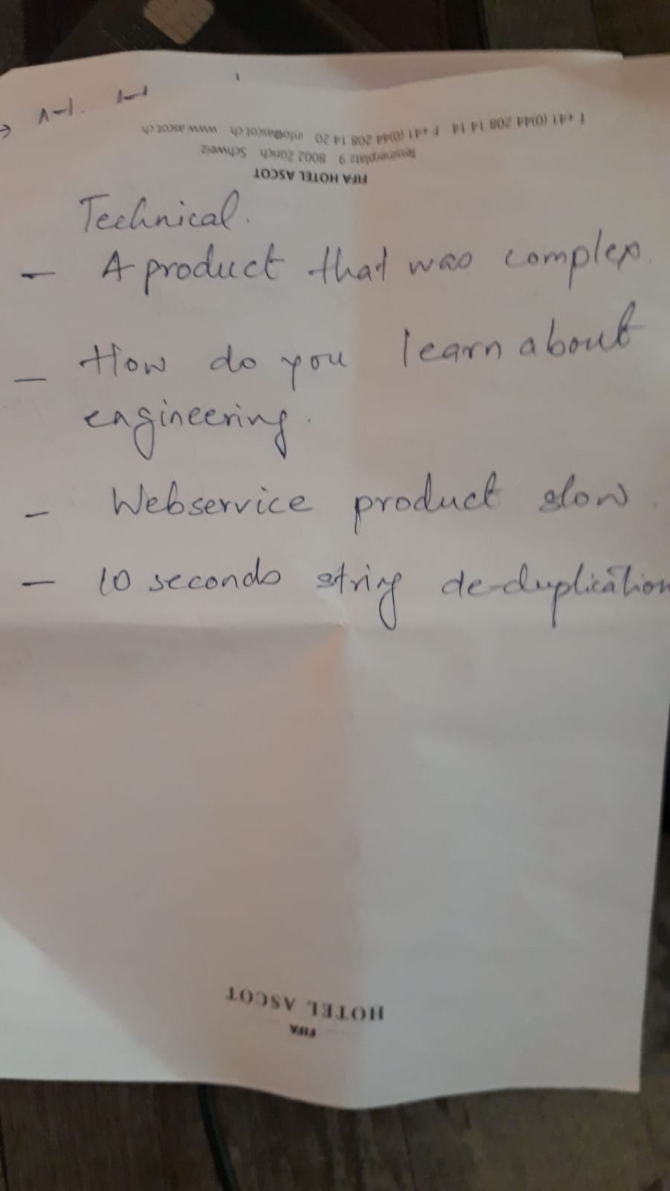

Slide 6
Technical Program Management - Goog
Describe SDLC for a project I worked including the milestones
Choose 1 milestone and determine entry & exit criteria for a milestone
Describe a time in a critical project that was not on track and what I did about it:
Give me an example of a process improvement I have made:
Can you tell the last time your technical background influenced the direction of the project

Slide 7
Tech round
Algo to figure out longest length of consecutive numbers in a members
System architecture for your current product
Dedup

Slide 8
From net

Slide 9
Interview 1 (Strategy) A project from your past experience that failed or didn’t go as intended. What were your learnings and what did you do abt it? I had an hypothesis but didn’t hit the nail. Let’s say you are PM on google maps, 12 years ago and Larry says go launch this in India. How would you go abt it ? ----> Why India? - 45% Worldwide GDP coming through emerging markets - exponential growth Why would Google be interested? How would you design the interface? Where would you get the data for cities, for traffic? Satellite images Crowd source API Interview 2 (Tech) Mobile native app vs server ...what are the technical issues you'll run into? Nope, Those are server side or architectural issues Nope, Those are generic client side issues Nope, Those are use case based issues What are the native app specific issues? Interview 3 (Everything) Asked again : A project from your past experience that failed or didn’t go as intended. What were your learnings and what did you do abt it? - 2 interviewers asked me the same question. What a next cool feature you would build on gmail? Auto delete Auto send email using AI. Let’s say google has decided to invest in inflight entertainment, you are a pm and have no challenges or restrictions - tech, people etc , what blue sky ideas would you have ? Interview 4 (Design) What is the next technical or non- technical product you have your eye on and why ? I bike to work and use Stevens creek trail. It has lot of potholes and cracks. Let’s say you want to get into the business of fixing them ? How would you assess the business opportunity? How would you make a case and pitch it to the city. (Estimation) Revenue Streams Access fee - Intangible - Less traffic, less pollution Let’s say you are a head of Google Phone & want to provide differentiation in your product offering. What would that be? Shopping Social Productivity -Subscriptiom Differenciate hardware, software, services Hardware: Camera (Projector) Flip or foldable Button for search Interview 5 (Design + Strategy) Let’s say you are asked to design a physical space - an art museum for kids, how would you go about it ? Where is this museum? Is it in the city? Are their any constraints such as space? Assumptions Enough space Parking Teachers, parents, kids - 3 personas Museum to cater to all the 3 Goal: Entertain and educate them Pain Points Kids Parents Teachers -Want to have fun -Want a way to monitor and let them do their thing -Accomodate large group of students Ideas Treasure hunt map for kids Mobile app called passport stamp - kids can discover places in museum and add a stamp to the app. Once they add, it shows more information about the place. VR headset to have an immersive experience App Talk to the kids using device Sensors to Google is building a new technology that can take you from San Francisco to New York in 2 hours ..What would you say? Build it or ignore it?

Slide 10
Design Google Calendar for children.
Design Google Camera.
How would you improve Google Maps?
How would you reduce Gmail storage size?
How would you improve restaurant search?
What’s favorite Google product? What do you like or not like about it?
If you were to build the next killer feature for Google, what would it be?
You’re part of the Google Search web spam team. How would you detect duplicate websites?
How would you solve homelessness in downtown San Francisco?
How would you re-design a set-top box?
How would you design a Mars Rover?
Create a mobile app for a chain of local orthodontist offices.
How do you reduce bandwidth consumption for Google Search, especially for developing countries with limited bandwidth?

Slide 11
ANALYTICAL QUESTIONS
Imagine we invented the Google Camera. How many Cameras would we sell in the 1st year?
How many queries per second does Gmail get?
How many iPhones are sold in the US each year?
What is the market for driverless cars in the year 2020?
How much storage and bandwidth do we need for Google Drive service in the next year?
How much storage do you need to store all Google Maps info?
How many new book titles are produced in the US, each year?
How many YouTube videos are watched in China, each year?

Slide 12
METRICS
Imagine you are the PM for Google+. Which metrics would you track?
Imagine Google+ metric X decreased 20% week over week. How would you diagnose? And what would you do?
After launching a new feature X, an important metric drops Y%. What would you do?
What's difference between median and mean?
Why is it important if an A/B test result is statistically significant?

Slide 13
TECHNICAL
Write an algorithm that detects meeting conflicts.
What happens when you type a URL into a browser and hit ENTER?
A friend is complaining that his website is not appearing in Google Search. Why would that happen?

Slide 15
LinkedIn

Slide 16
Onsite
Strategy / Leadership As a PM in your current company, what metrics did you use to prioritize the roadmap? How did you convince the management and the engineering team that this was the key metric to focus on? What challenges did you face? What other metrics did you consider? Business Acumen / Leadership What is the competitive landscape of your product? How did you price your product - Explain the process of building the pricing model and tiering of your product? Product Design Build a product to track and manage KPIs What metrics would you use to measure the success? Market Sizing Jointly, what opportunities do Microsoft and LinkedIn have? Can you size the market for the opportunity? What are the risks to make it successful? Technical / System Design <More conversational rather than a direct question.> Topics: Data Fabric at Scale for LinkedIn, Microservice Architecture, HDFS/Gobblin/Kafka

